Slide 1
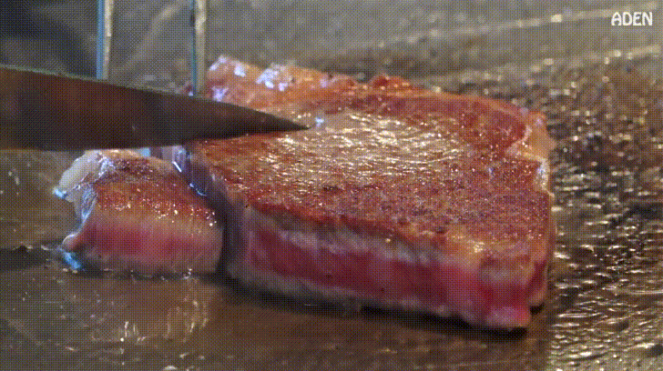

Slide 2
ai steak

Slide 3
staik

Slide 4
Text generation using neural networks

Slide 5
RNN

Slide 6
char RNN

Slide 7
Sliding window
“Hello darkness my old friend”,

Slide 8
Sliding window
“Hello darkness my old friend”,

Slide 9
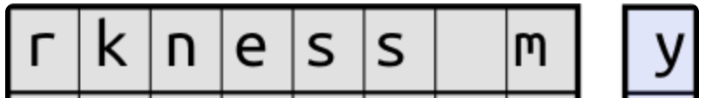

Slide 10
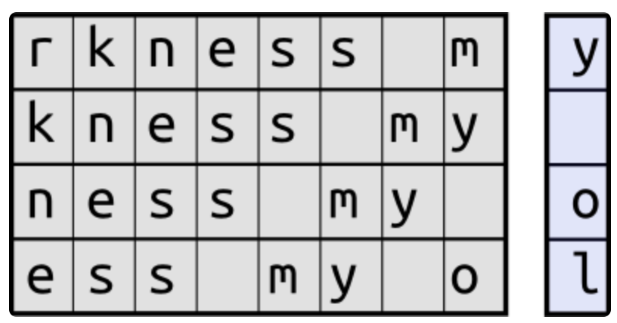

Slide 13
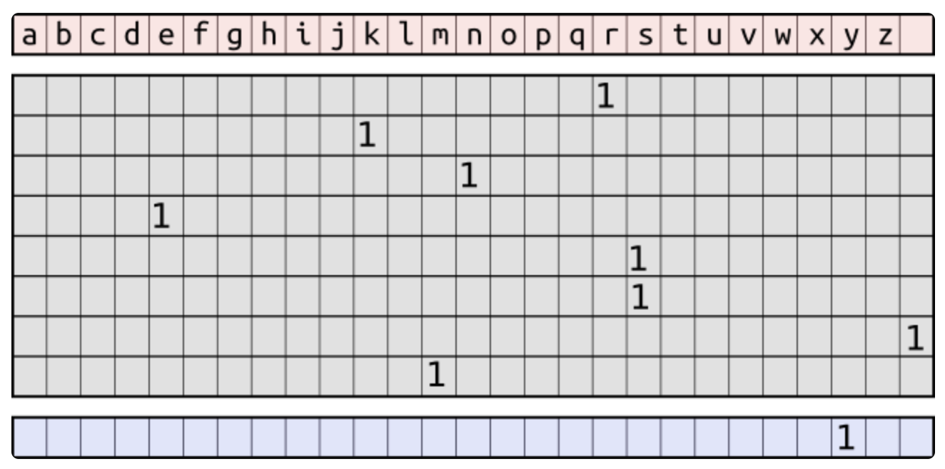

Slide 14
textgenrnn

Slide 15
textgenrnn
Text ganuuuuurn?!?!?

Slide 17
takes in an input of up to 40 characters

Slide 18
takes in an input of up to 40 characters
converts each character to a 100-D character embedding vector
Notes:
Preserves context and meaning

Slide 19
takes in an input of up to 40 characters
converts each character to a 100-D character embedding vector
fed into a 128-cell LSTM

Slide 20
takes in an input of up to 40 characters
converts each character to a 100-D character embedding vector
fed into a 128-cell LSTM
another fed into a 128-cell LSTM

Slide 21
takes in an input of up to 40 characters
converts each character to a 100-D character embedding vector
fed into a 128-cell LSTM
All three layers are then fed into an Attention layer to weigh the most important temporal features and average them together
another fed into a 128-cell LSTM
Notes:
Like a forget gate

Slide 22
takes in an input of up to 40 characters
converts each character to a 100-D character embedding vector
fed into a 128-cell LSTM
All three layers are then fed into an Attention layer to weight the most important temporal features and average them together
another fed into a 128-cell LSTM
That output is mapped to probabilities for up to 394 different characters that they are the next character in the sequence, including uppercase characters, lowercase, punctuation, and emoji.

Slide 23
takes in an input of up to 40 characters
converts each character to a 100-D character embedding vector
fed into a 128-cell LSTM
All three layers are then fed into an Attention layer to weight the most important temporal features and average them together
another fed into a 128-cell LSTM
contextual mode, where the model will take a label as an input
That output is mapped to probabilities for up to 394 different characters that they are the next character in the sequence, including uppercase characters, lowercase, punctuation, and emoji.

Slide 24
measures the performance of a classification model whose output is a probability value between 0 and 1

Slide 26
“since the original pretrained network has a much more robust "knowledge" initially, the new textgenrnn trains faster and more accurately in the end, and can potentially learn new relationships not present in the original dataset ”

Slide 27
let’s look at what’s at steak

Slide 28
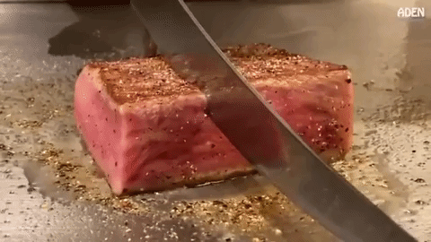

Slide 29
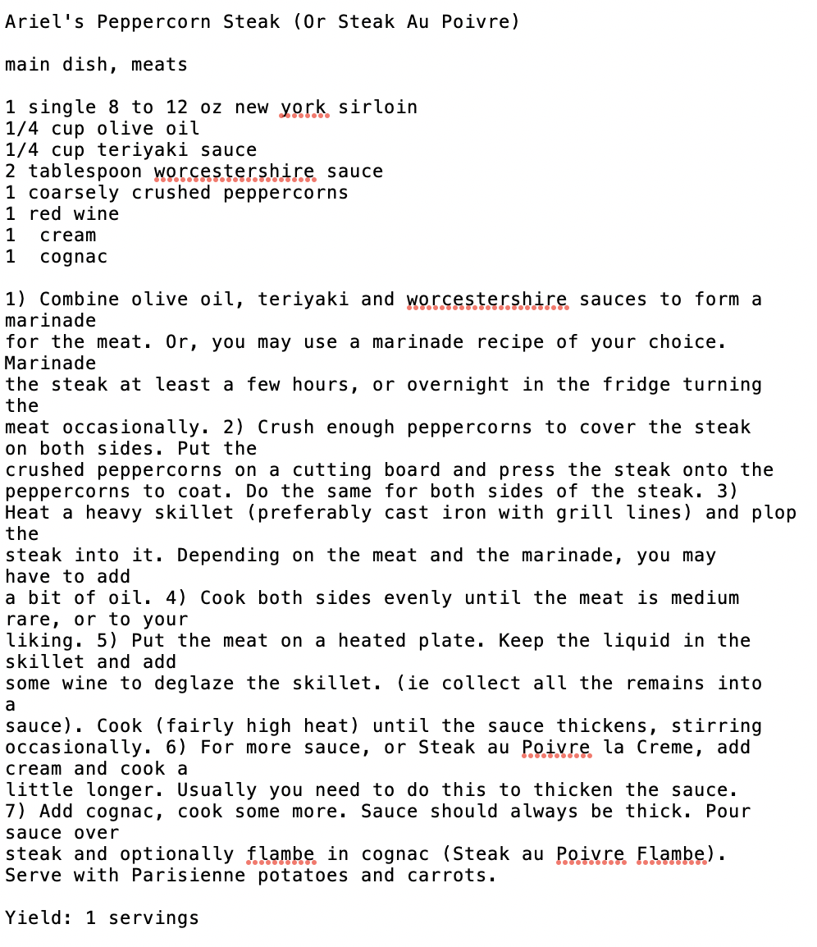
Steak recipe dataset
444 steak recipes
415,918 character sequences
20 epochs
80-20 train-test split

Slide 30

more diversity
less diversity
more mistakes
less mistakes
“easily excited”
0.0
1.0
Temperature
Temperature
“Performing softmax on larger values makes the LSTM more confident (less input is needed to activate the output layer) but also more conservative in its samples (it is less likely to sample from unlikely candidates).
Using a higher temperature produces a softer probability distribution over the classes, and makes the RNN more “easily excited” by samples, resulting in more diversity and also more mistakes.”

Slide 31
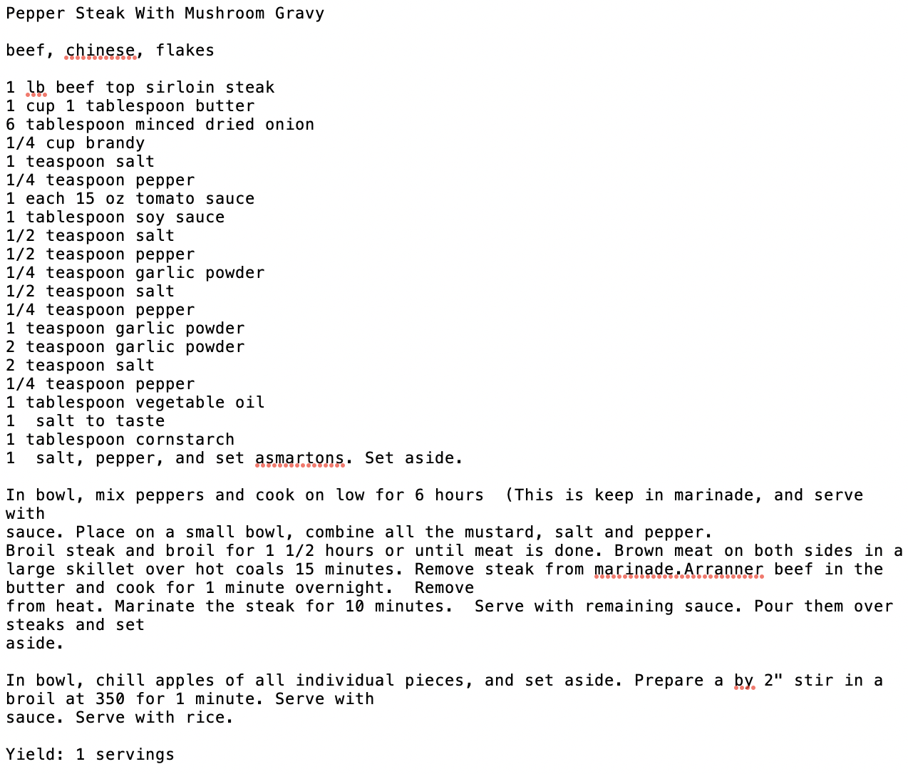
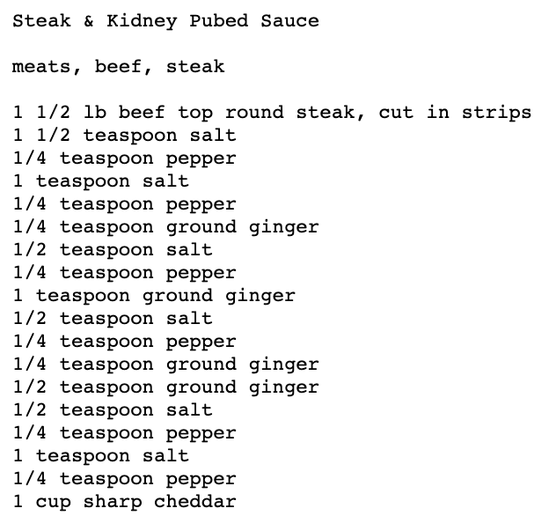
0.2
rare

Slide 32
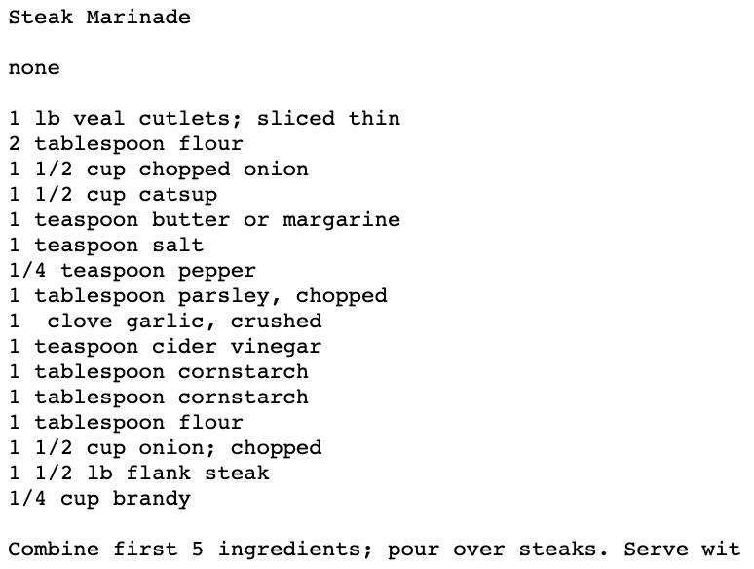
0.5
medium

Slide 33
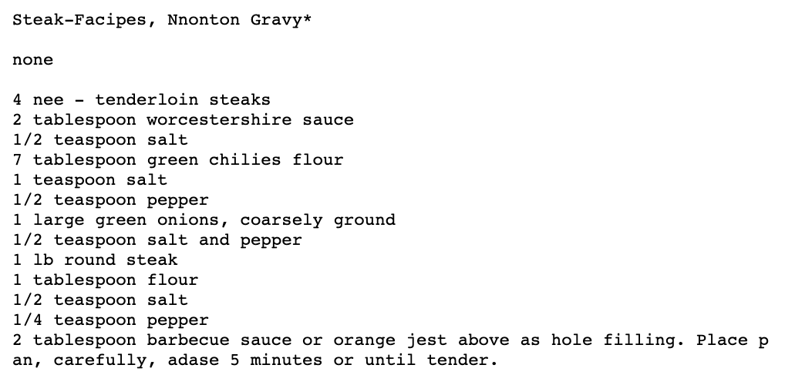
1.0
well done

Slide 34
Points of improvement
Use bidirectional lstm?
More epochs?
More data?
Uniformly formatted data?
Expand to recipe generation that has a context label based on cuisine?

Slide 35
Additional learning tip

Slide 36
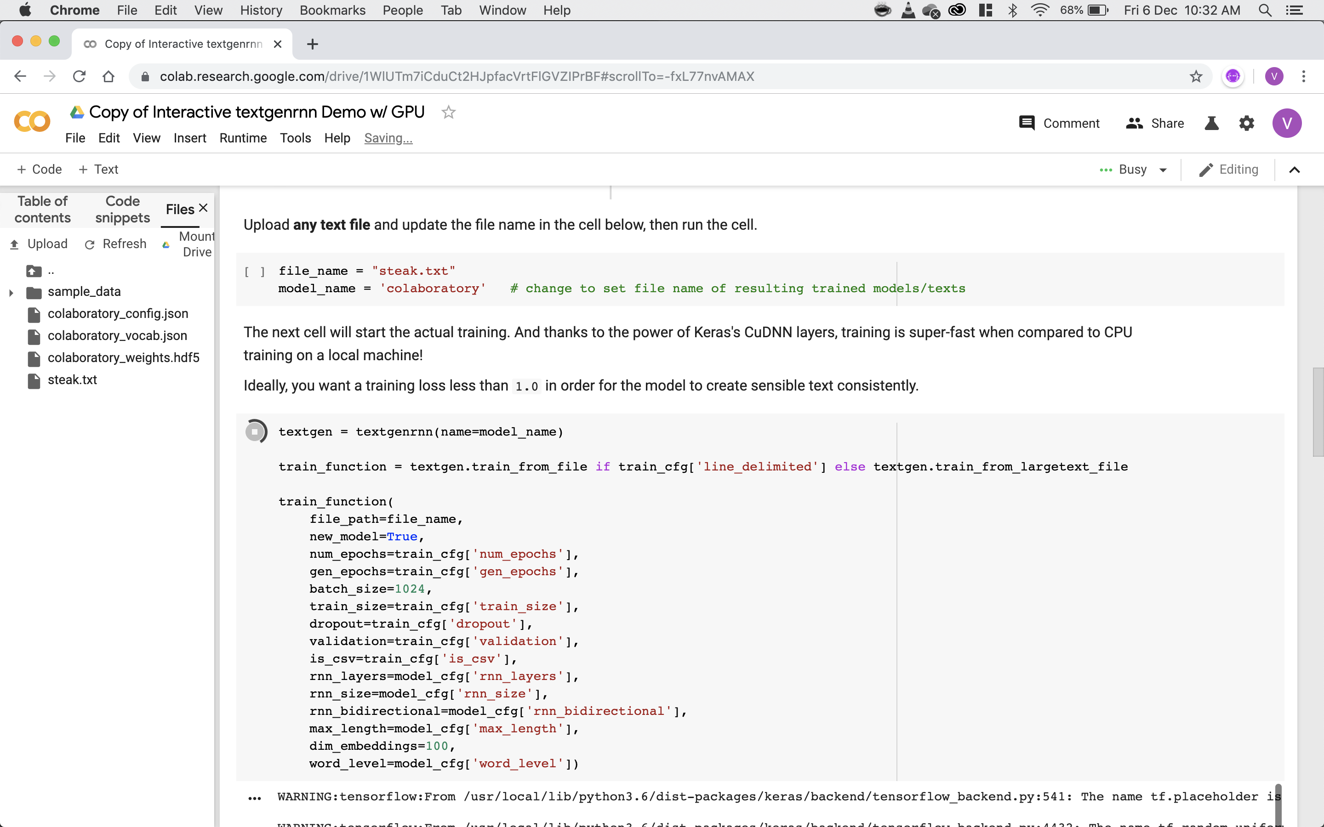

Slide 38
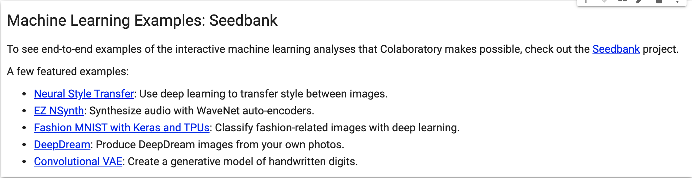

Slide 39
For the things we have to learn before we can do them, we learn by doing them.
- Aristotle

Slide 40
